Slide 1
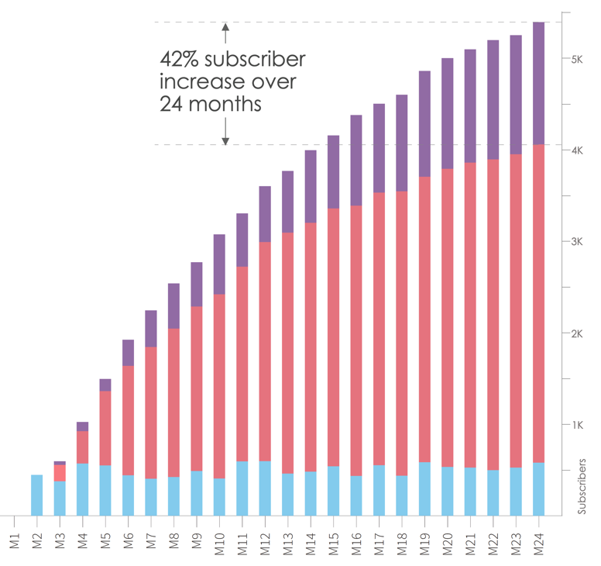
Retaining an additional 5% of subscribers each month leads to long-term growth
A 5% increase in the customer retention rate each month leads to 42% more subscribers in 24 months
Boosting the retention rate (from 88% to 93%) creates compound value over time
New subscribers (400 to 600 per month)
Renewals (monthly retention rate of 88%)
Renewals (additional 5% retention for total monthly retention rate of 93%)

Slide 2
The power of retention on profitability
Recovering 15-30% of terminally failed payment transactions:
Increases renewals and extends customer lifetime value
Improves the customer experience
Reduce DSO and increase operational efficiencies
Anchored on machine learning and AI algorithms developed and refined over the course of 15+ years
Coexists with your existing billing platform and order to cash processes
Profits
Profits
Costs
Revenue
Costs
Acquisitions
Renewals

Slide 3

Regardless of the industry or product, Vindicia Retain drives success
Real-world payment recovery success rates achieved by Vindicia Retain clients
Publishing
59.98%
Health and wellness
49.58%
Web, home, and security
52.54%
Retail and leisure
39.60%
Finance and business
30.30%
TV, video, and gaming
39.41%
Notes:
This success rates reflect the best performing Vindicia Retain clients in each category

