Slide 1
The 9X Subscription Growth Secret
How subscription growth stalls and what to do about it.

Slide 2
History of Retention Success
Growing memberships since 1993
Responsible for 24 in 1999
Pivot to for-profit memberships in 2004
Sold membership in 2012
Work behind the scenes within hundreds of subscription companies, from mom and pops, entrepreneurs, tech start-ups and billion-dollar subscription brands.

Slide 3
Focusing on Retention Rate

Slide 4
Standard Subscription Dashboards

Slide 6
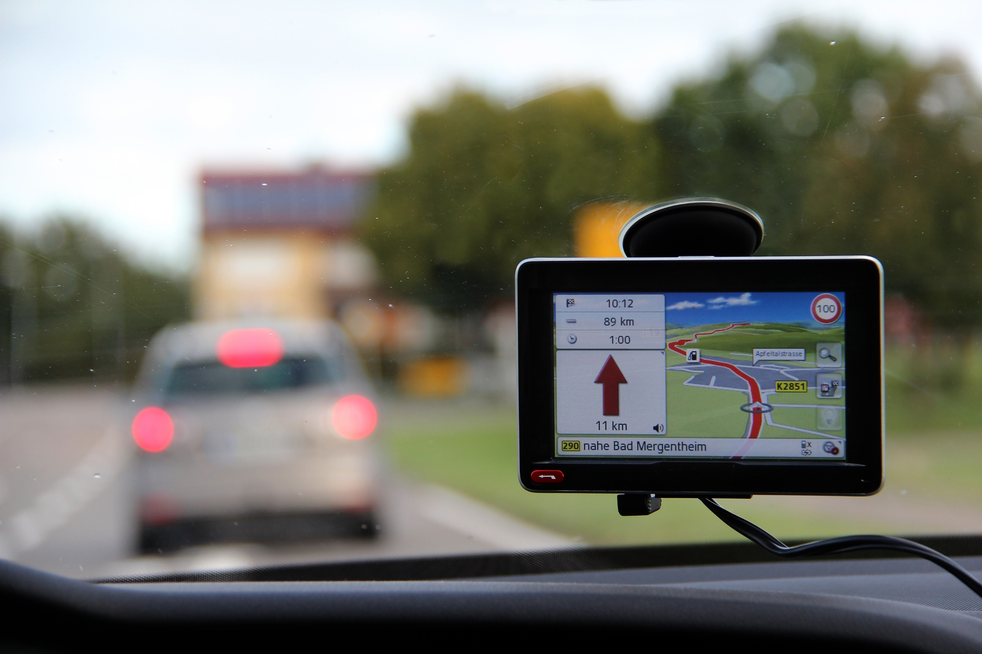

Slide 7
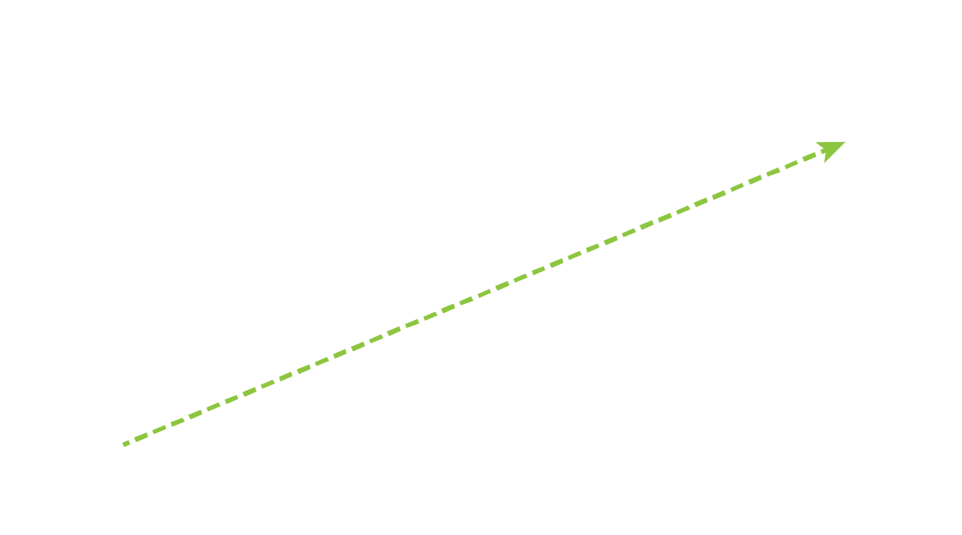
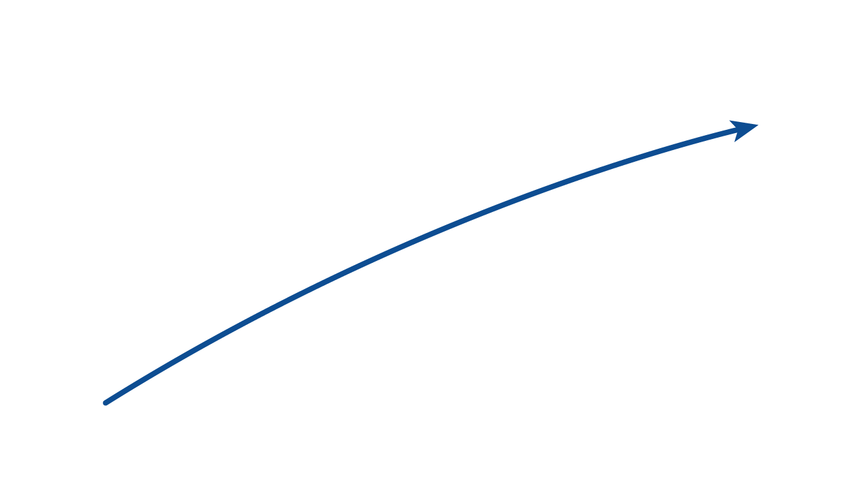
1,000 new subscribers monthly with 8% churn rate at $75.00 monthly
MRR $592,000

Slide 8
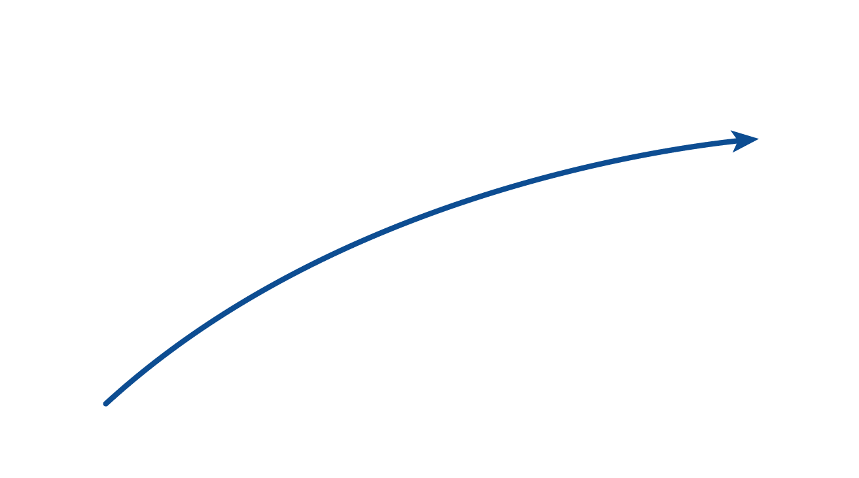
1,000 new subscribers monthly with 8% churn rate at $75.00 monthly
MRR $810,750
MRR $592,000

Slide 9
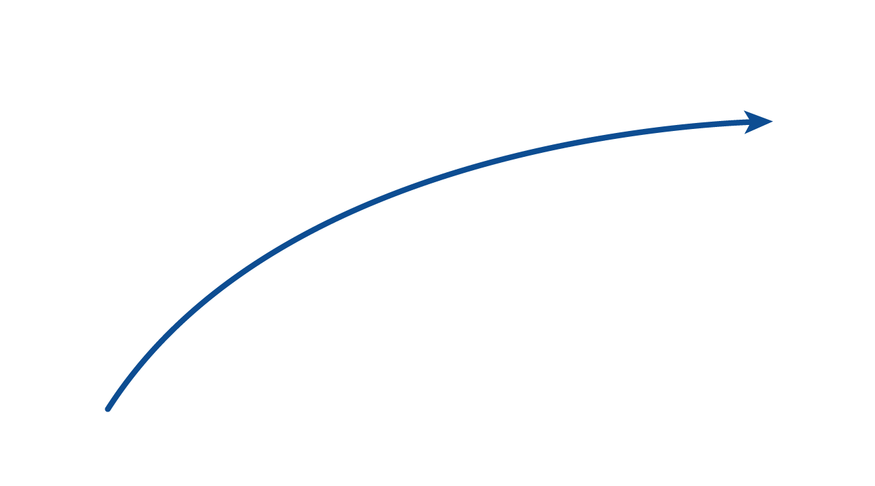
1,000 new subscribers monthly with 8% churn rate at $75.00 monthly
MRR $890,850
MRR $810,750

Slide 10
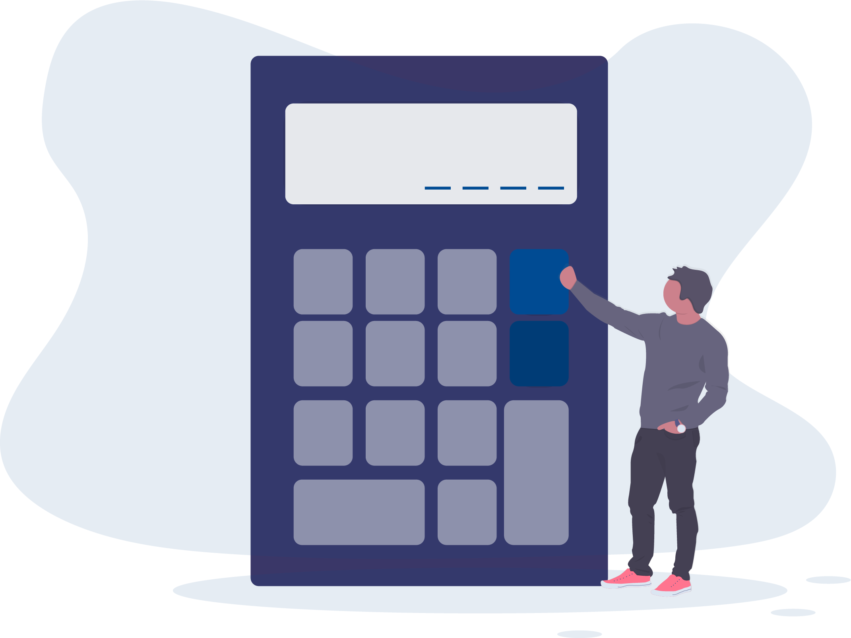
Subscription Growth Ceiling
New Subscribers ÷ Churn Rate = Membership Growth Ceiling
1,000 ÷ 8% = 12,500

Slide 11
Customer Acquisition Cost (CAC)
Marketing Expenses ÷ # of New Subscribers = CAC
$500,000 ÷ 1,000 = $500.00

Slide 12
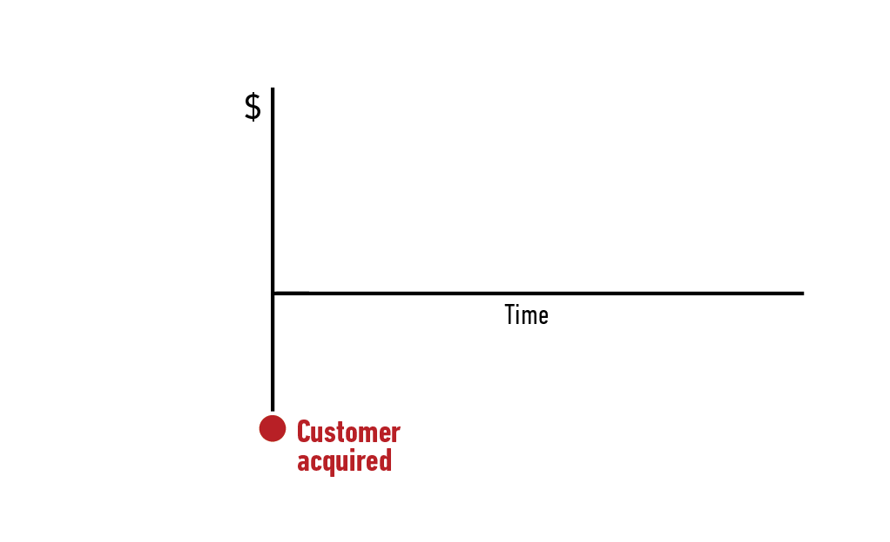
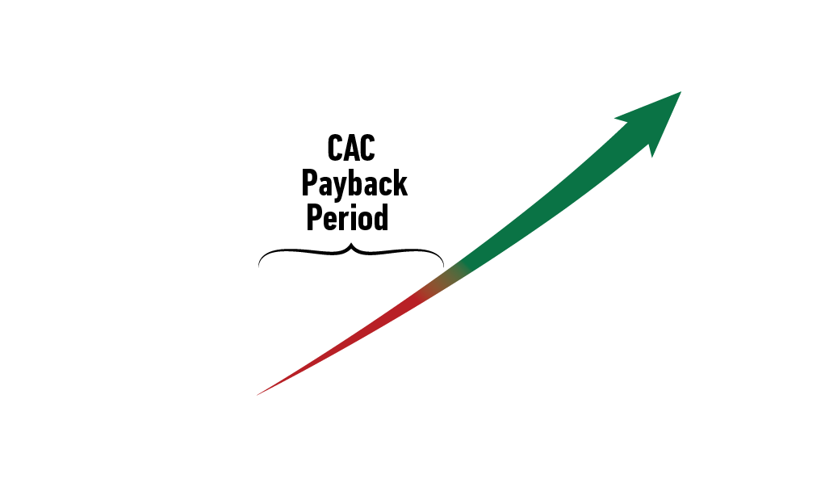
CAC Payback Period

Slide 13
CAC Payback Period
CAC - $500.00
Average RPM - $75.00
WRONG
$500 ÷ 75 = 6⅔

Slide 14
Subscription Cohort Analysis
Subscription with average 8% monthly churn rate
Month 1 | 100%
Month 2 | 78%
Month 3 | 66%
Month 4 | 60%
Month 5 | 54%
Month 6 | 50%
Month 7 | 47%
Month 8 | 43%
Month 9 | 40%
Month 10 | 39%
Month 11 | 38%
Month 12 | 37%

Slide 15
CAC Payback Period CAC - $500.00
 | Retention | Avg. RPM | Avg. Cumulative RPM
Month 1 | 100% | $75.00 | $75.00
Month 2 | 78% | $58.50 | $133.50
Month 3 | 66% | $49.50 | $183.00
Month 4 | 60% | $45.00 | $228.00
Month 5 | 54% | $40.50 | $268.50
Month 6 | 50% | $37.50 | $306.00
Month 7 | 47% | $35.25 | $341.25
Month 8 | 43% | $32.25 | $373.50
Month 9 | 40% | $30.00 | $403.50
Month 10 | 39% | $29.25 | $432.75
Month 11 | 38% | $28.50 | $461.25
Month 12 | 37% | $27.75 | $489.00
Month 13 | 36% | $27.00 | $516.00

Slide 18
9X Subscription Growth
Ad Focused
LTV Focus
$53 CPA
Generating 1,000 new subscribers monthly
vs
$146 CPA
Generating 10,000 new subscribers monthly
$53,000 Ad Budget
$1,460,000 Ad Budget

Slide 19
Subscription Retention Systems?
Pricing rates, tiers & increases
New subscriber conversion and offers
Onboarding for retention and short-term LTV
Monetization of new, canceled and long-term subscribers
Subscriber cancelation processes optimized for retention
Past subscriber recovery campaigns
Forward looking subscription KPIs

Slide 20
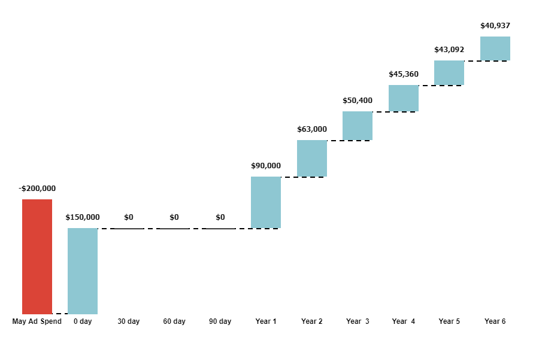
Subscriber Cohort LTV Forecast

Slide 21
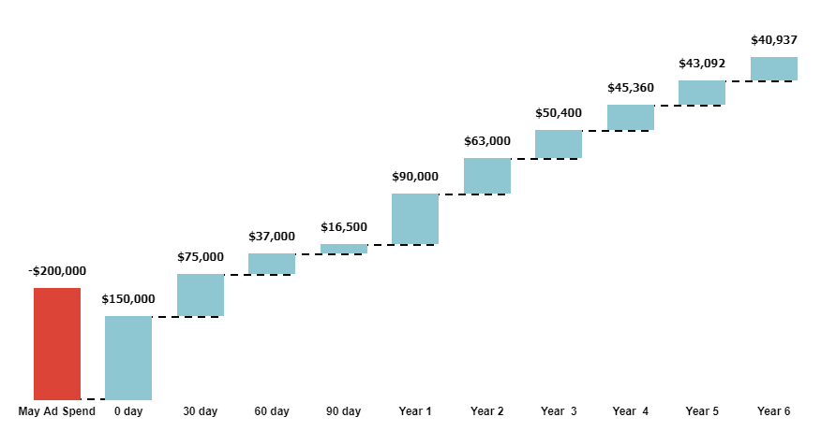
Subscriber Cohort LTV Forecast
After Implementing upsells
$278,500 revenue first 30-days
$225,000 revenue first 30-days

Slide 36
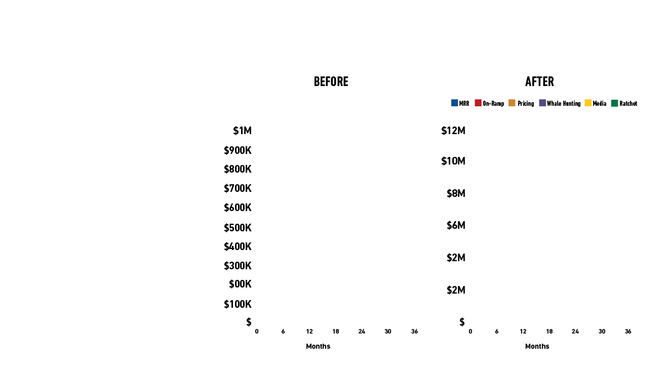
10X Recurring Revenue Calculator
Monthly Recurring Revenue
Current Members |  |  | -
Avg new members per month |  |  | 1,000
Monthly advertising costs |  |  | $500,000
Customer acquisition cost |  |  | $500
Churn rate |  |  | 8.00%
Subscription rate |  |  | $75.00
Member On Ramp
Goal retention rate |  |  | 5.60%
Member Focused Offer
Pricing improvement |  |  | 20.00%
Triple Monetization Multipliers
Multiplier #1
% of members |  |  | 20%
buy product priced |  |  | $360
Multiplier #2
% of members |  |  | 4%
buy product priced |  |  | $1,440
$4M
$200K
Easy Media Money
Revenue per member |  |  | $10
New Subscriber Rachet
New revenue to ad budget |  |  | $50

Slide 37
🎁www.10xRecurringRevenue.com

Slide 38
Subscription Retention Systems?
Pricing rates, tiers & increases
New subscriber conversion and offers
Onboarding for retention and short-term LTV
Monetization of new, canceled and long-term subscribers
Subscriber cancelation processes optimized for retention
Past subscriber recovery campaigns
Forward looking subscription KPIs

Slide 39
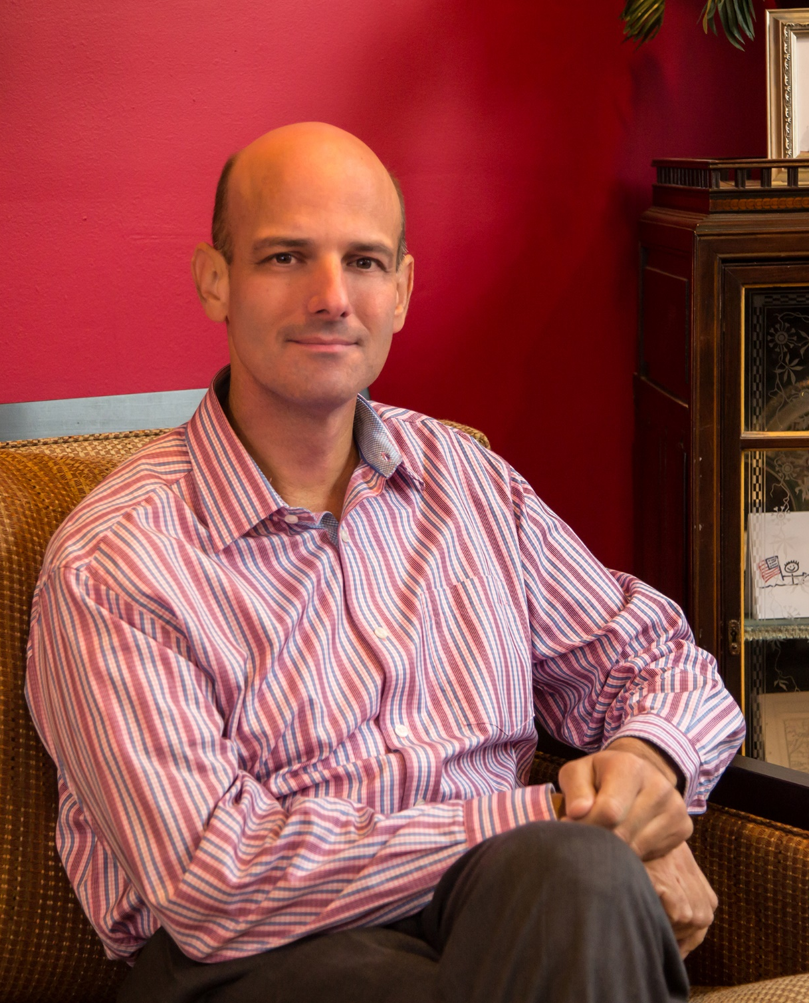
Robert Skrob
📩 Robert@BeUnleavable.com
Be Unleavable
🎁www.10xRecurringRevenue.com
🔁 EvergreenRetentionMachine.com

